Slide 1
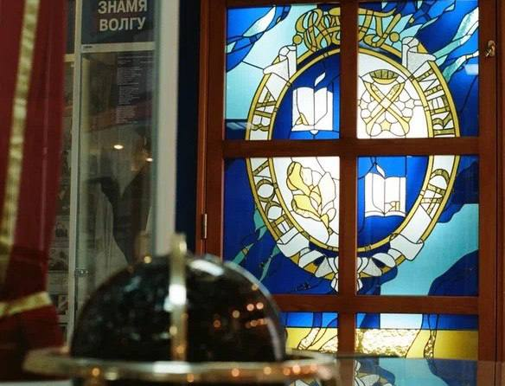
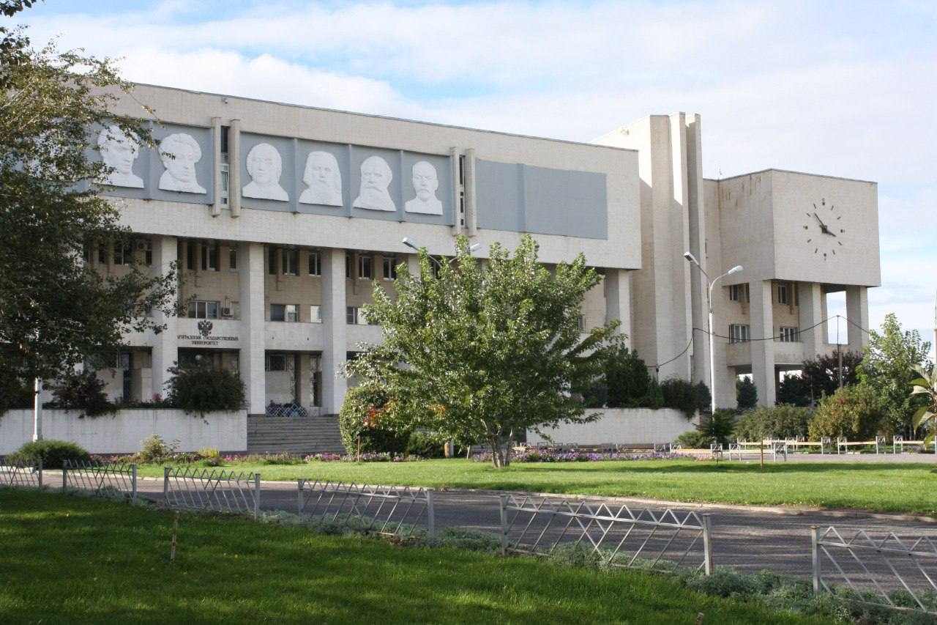
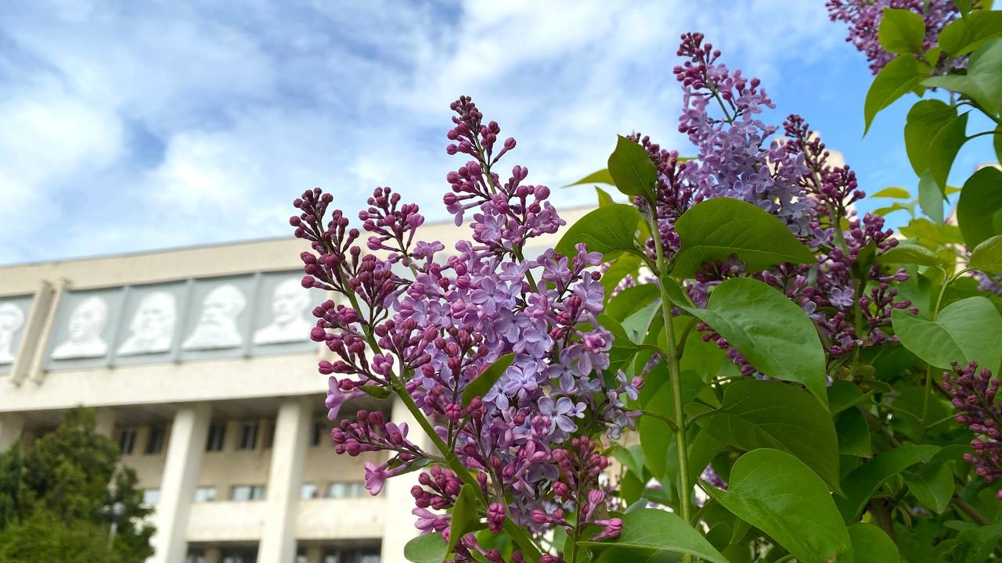
Volgograd state University
Situated at the geographical center of Volgograd
Offers bachelor, master and postgraduate programs

Slide 2
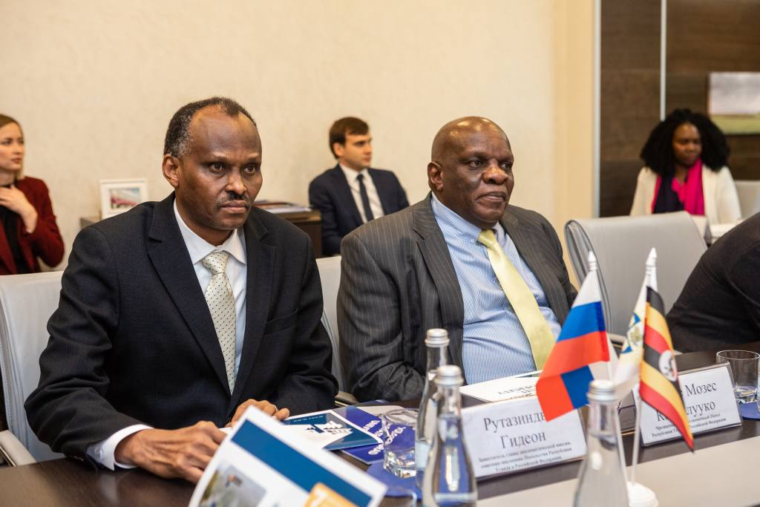
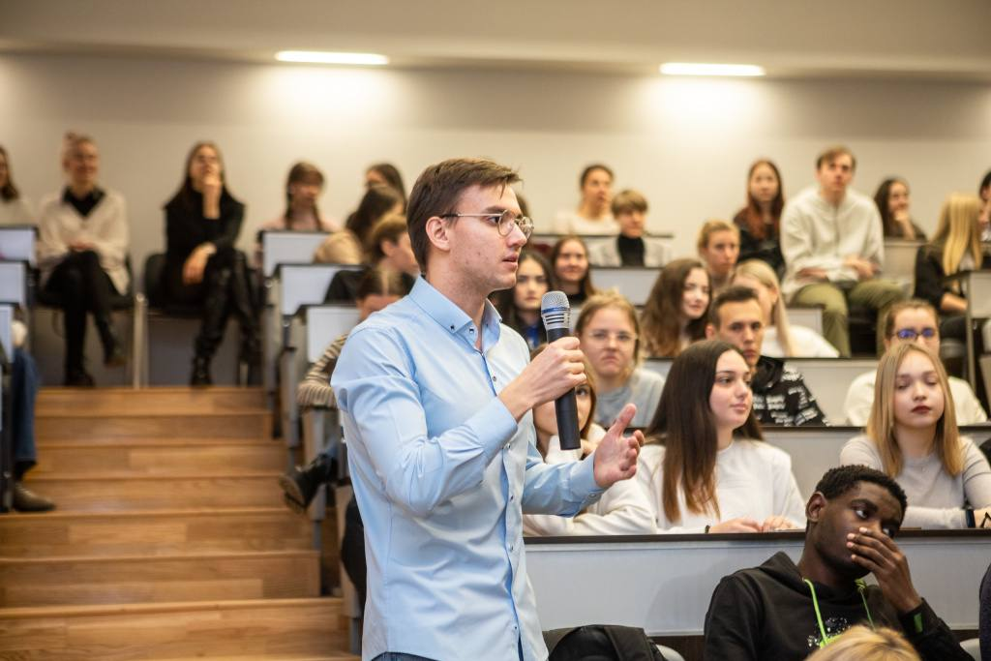
Master Program “International Relations” Subject: Public Diplomacy

Slide 3
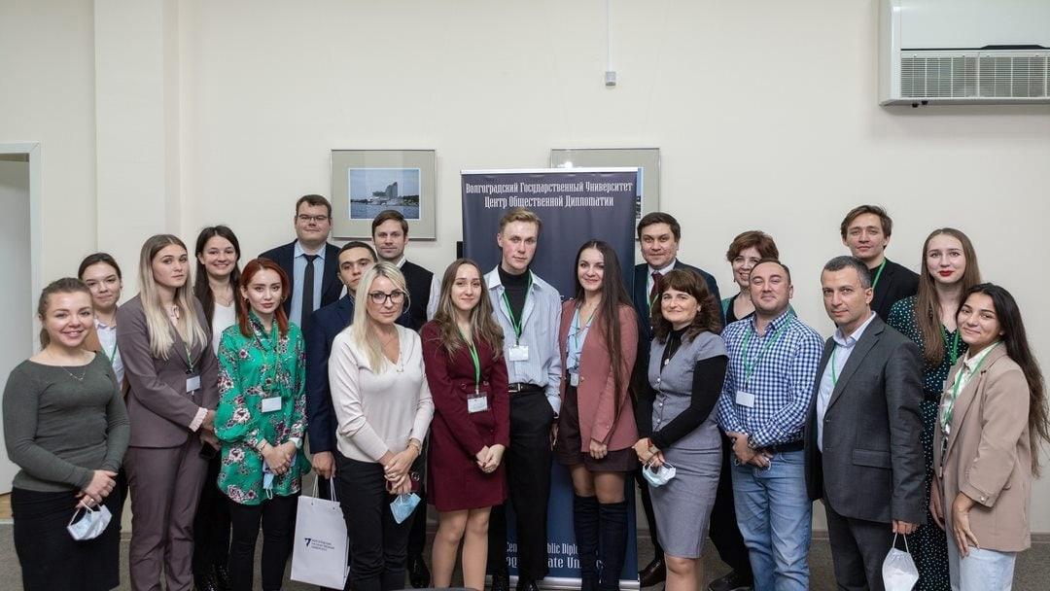
International Relations
Program Public Diplomacy (in English)
Our alumnus is a specialist supporting the development of public diplomacy for different kinds of organizations (non-state actors, state supporting programs), who can analyze ongoing relations between states and nonstate actors of the Global Politics.
We study public diplomacy at the city of Public Diplomacy!
Volgograd is a twin city for Chennai (India), Port Said (Egypt), Jilin (China), Krusevac (Serbia), Izmir (Turkey), Yerevan (Armenia) and others.

Slide 4
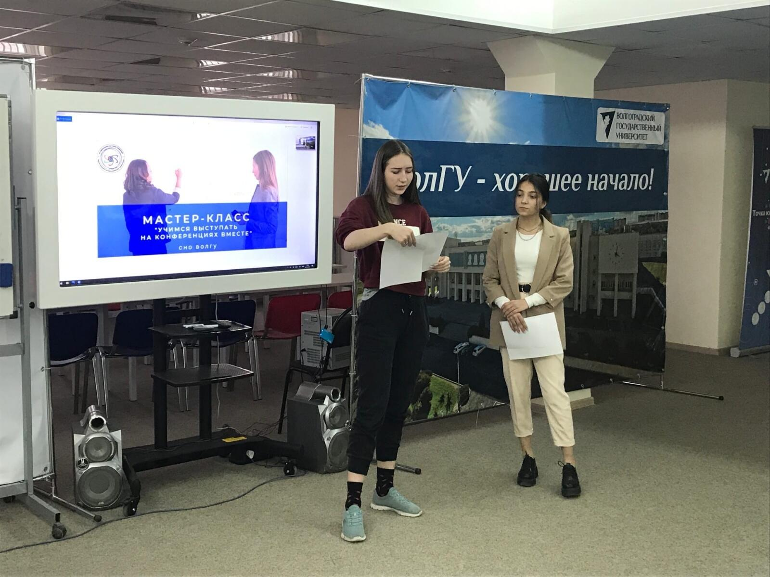
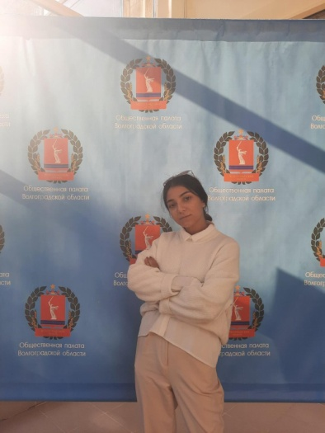
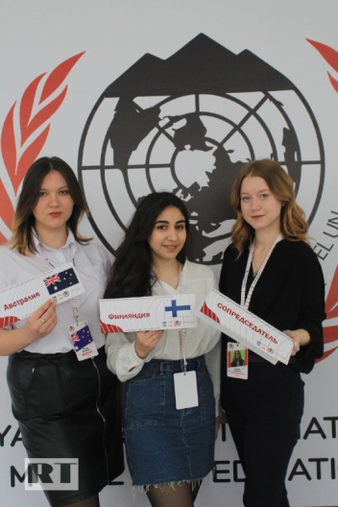
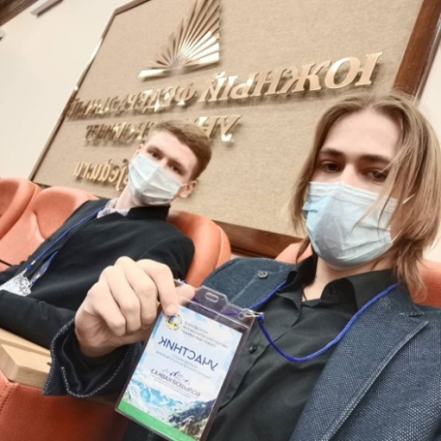
International Relations
Our curricula:
Economic diplomacy
Communications in the field of public diplomacy
Public diplomacy
Urban diplomacy
Cross-border cooperation of regions
Leading world Powers and regional subsystems in international relations
Megatrends and global problems
The process of making foreign policy decisions
Interaction of the state and non-state structures in the international arena

Slide 5
Our partners:
Institute of Latin America (Russian Academy of Sciences)
Institute of USA and Canada (Russian Academy of Sciences)
Erevan State University (Armenia)
Belarus State University
Bharath Institute of Science and Technology (India)
Teheran State University (Iran)
Eurasian National University named after Lev Gumilev (Kazakhstan)
Jilin State University (China)
Center of Public Diplomacy (Volgograd)
Volgograd Center of International Humanitarian Cooperation

Slide 6
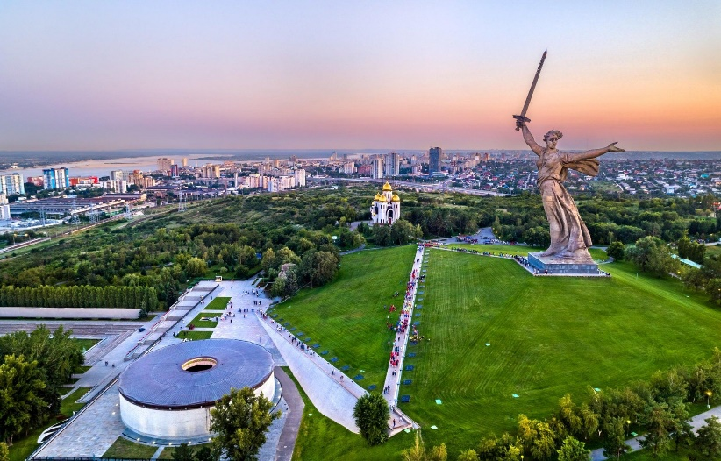
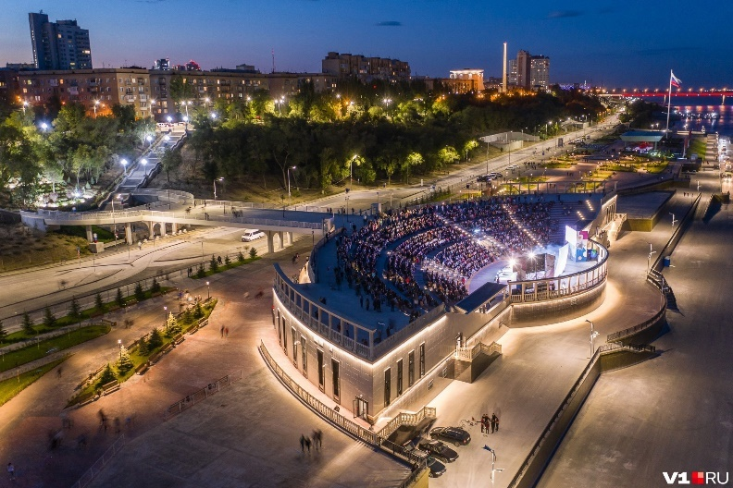
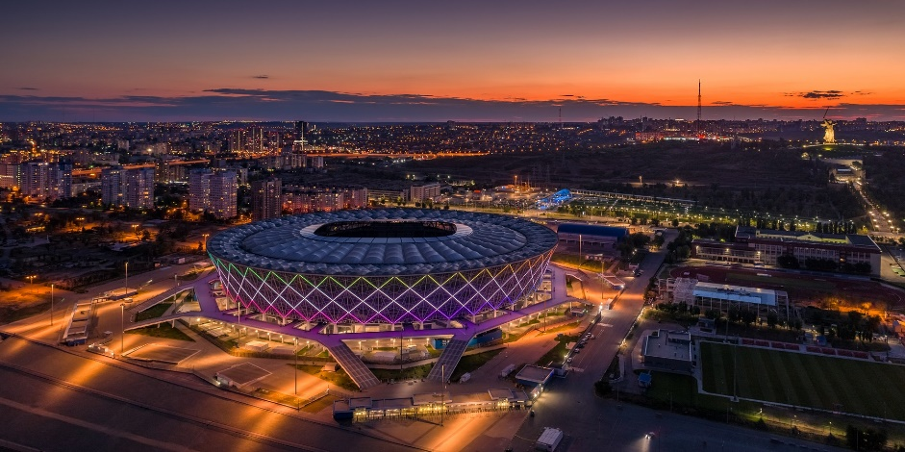
Information About Volgograd
Situated in the Russian South.
Mild climate in Winter and very warm in Summer.
1,5 hours to fly from Moscow.
International airport (flights to: Istanbul, Antalya, Yerevan, Baku, Dubai).
The crossroad for the South-North and East- West corridors.
Historical sights and modern locations for an active rest!

Slide 7
Volgograd is a center of Public Diplomacy.
Study Public Diplomacy with us!

